Slide 1
Bio Medical Data Analysis
Presented by
V. Pradeep Goud - 46005370

Slide 2
Contents
Business Scenario
Minimum System Requirements
Dimension Model
SSIS ETL Operations
Loading Dimensions and Facts
Loading the data to SQL Server
Reports in Power BI

Slide 3
Business Scenario
To Develop a Bio Medical Data warehouse in Power BI/SSRS and to analyze data from Bio medical data.
The aim of the project is to implement a clinical and genomic data warehouse based on the schema design using the SQL Server system.

Slide 4
Minimum System Requirements
• Intel Pentium 90 or higher (P166 recommended)
• Microsoft Windows 2010 or above.
• Memory: 4GB of RAM (4 GB or more recommended)
• Internet Explorer 10 or higher
• Oracle 11G / SQL Server 2012 or higher
• Informatica 10.2.0 / SSIS /Data Stage / Abinitio
• Tableau Desktop / SSRS / PowerBi / Qlickview

Slide 5
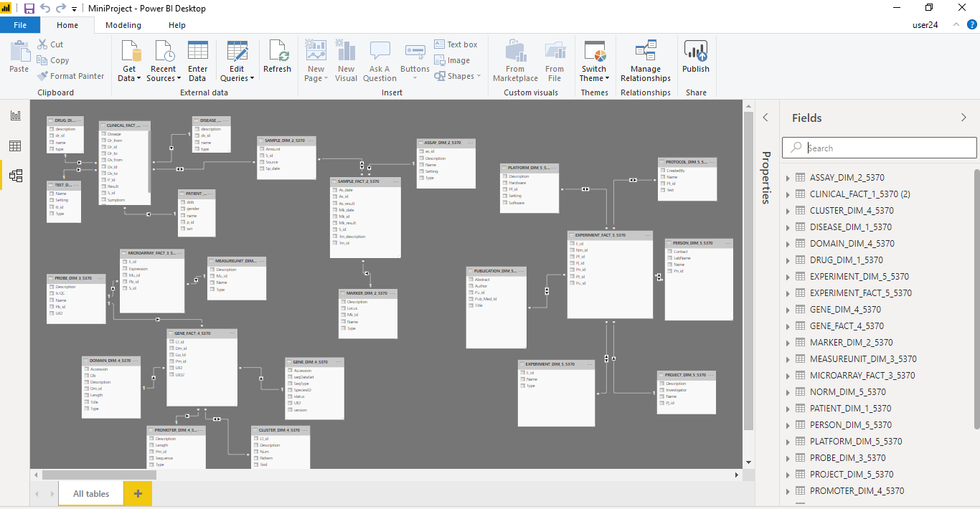
Dimension model

Slide 6
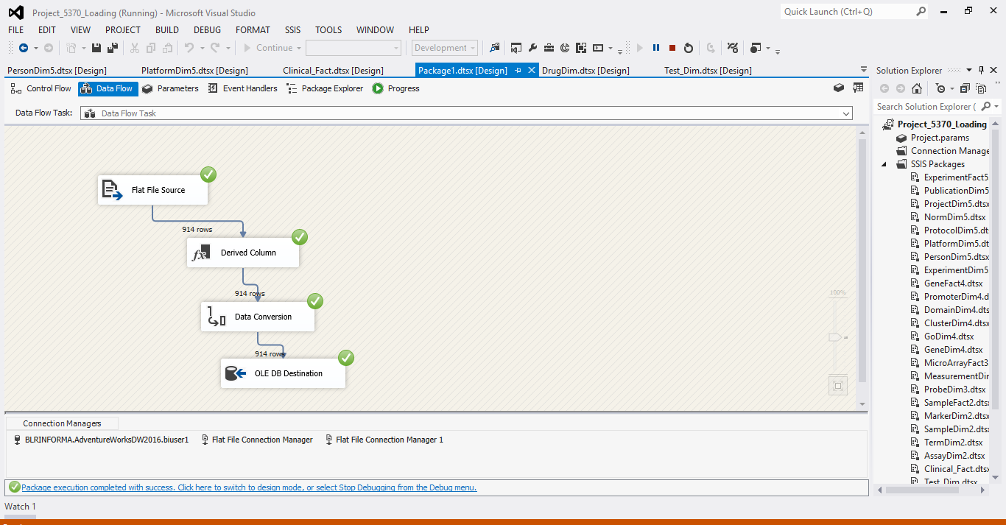
SSIS ETL Operations: Loading Fact table

Slide 7
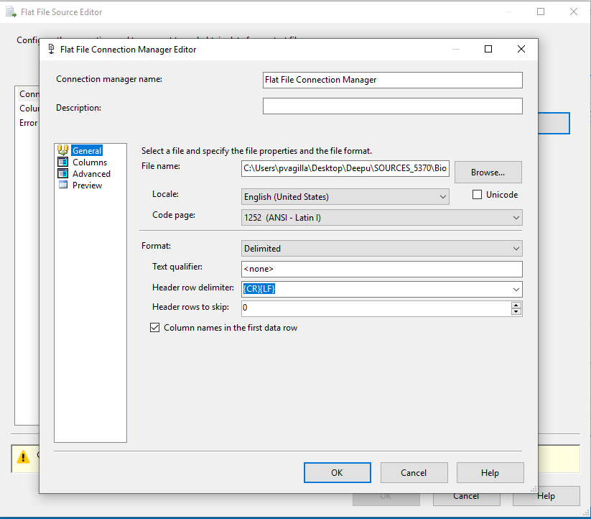

Slide 8
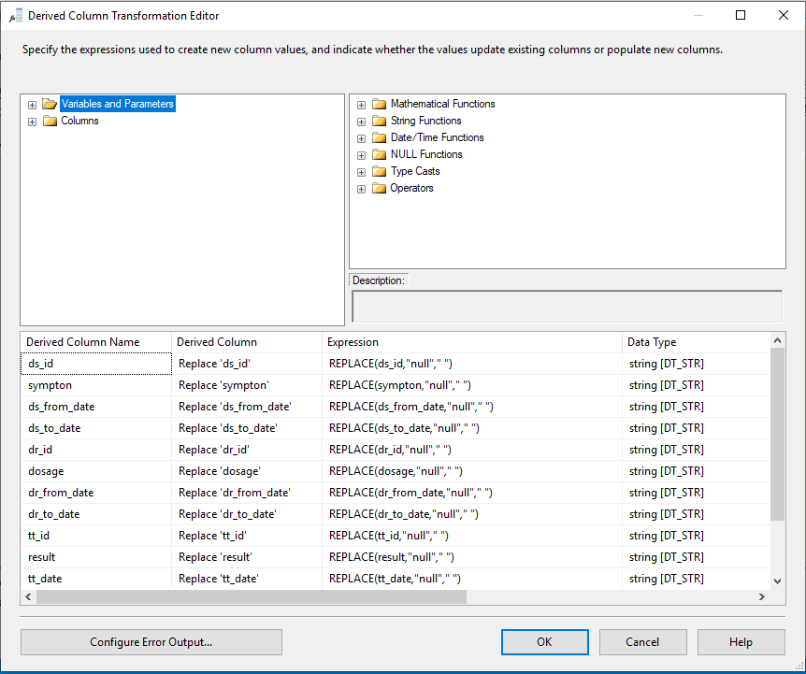

Slide 9
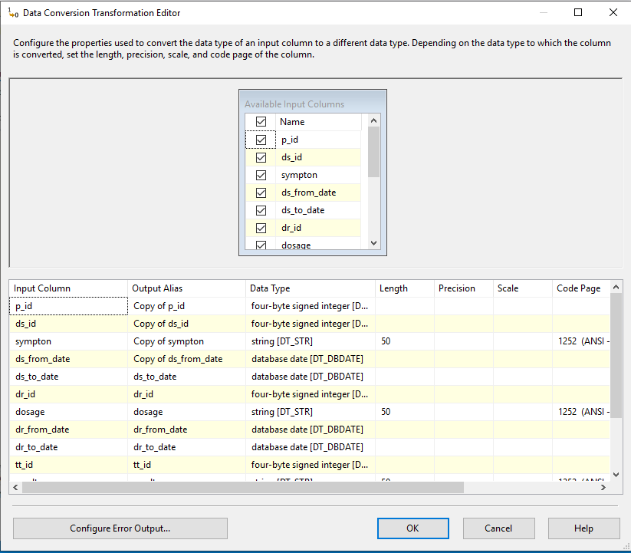

Slide 10
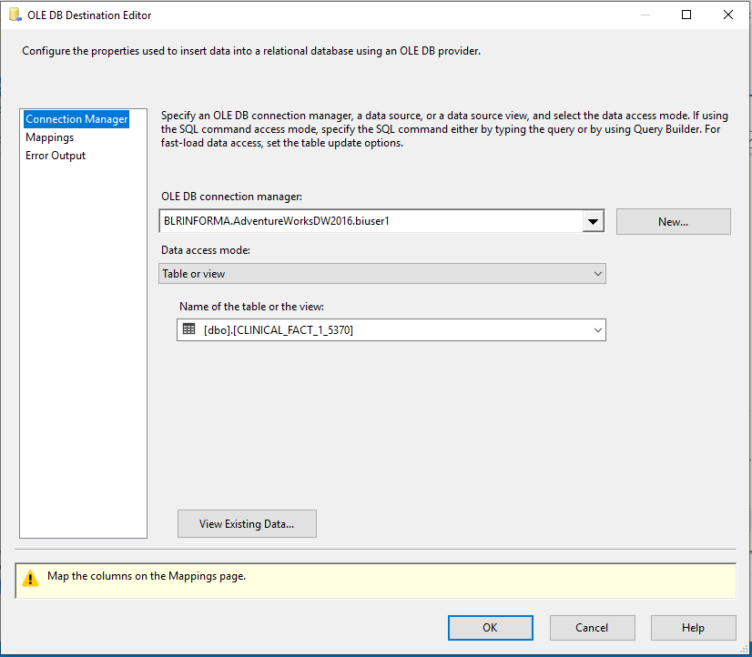

Slide 11
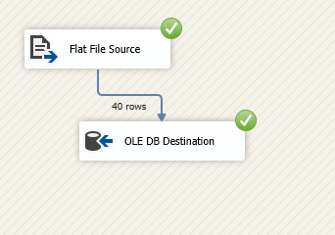
Loading Dimensions

Slide 12
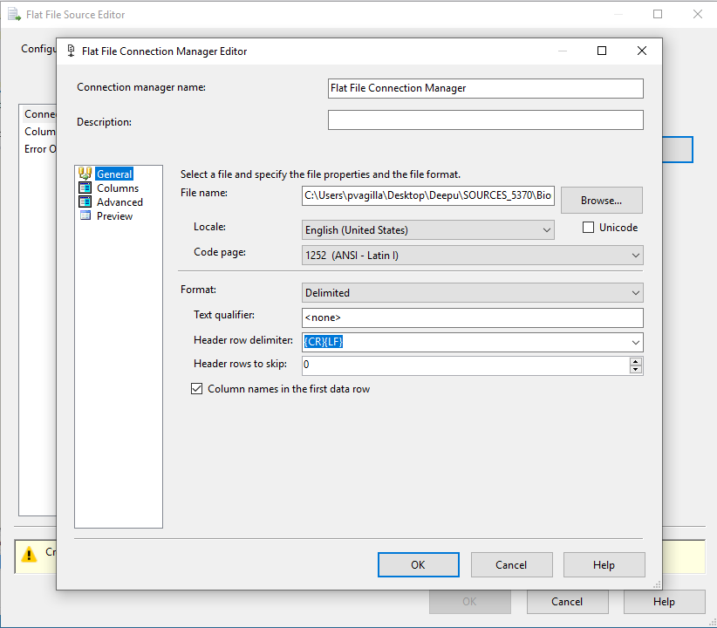

Slide 13
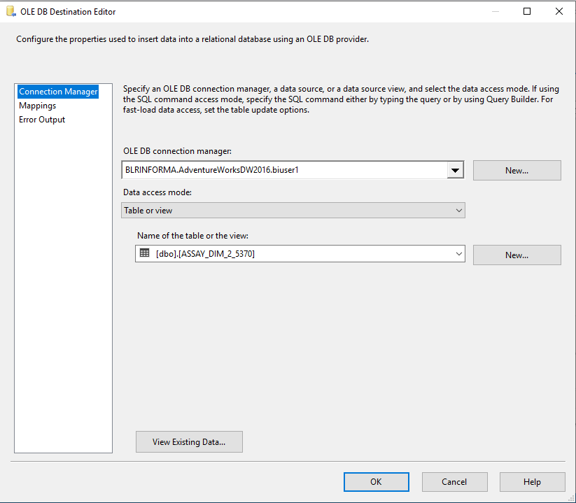

Slide 14
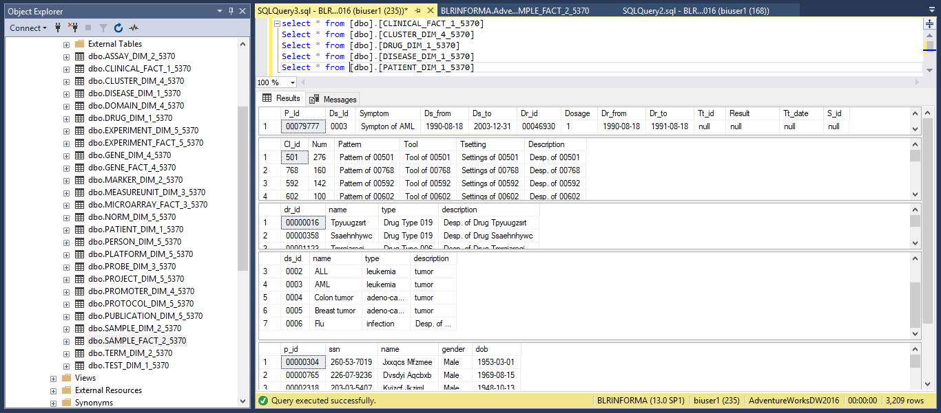
Loading the data in SQL Server

Slide 15
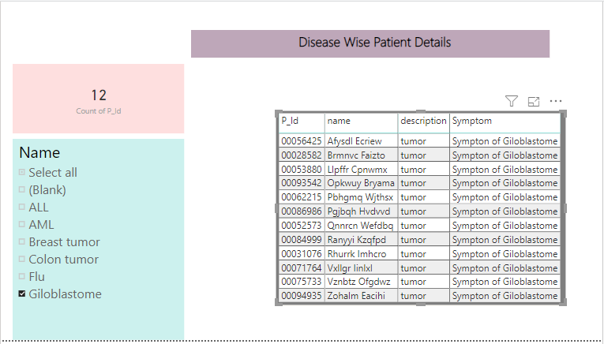
Reports in Power BI

Slide 16
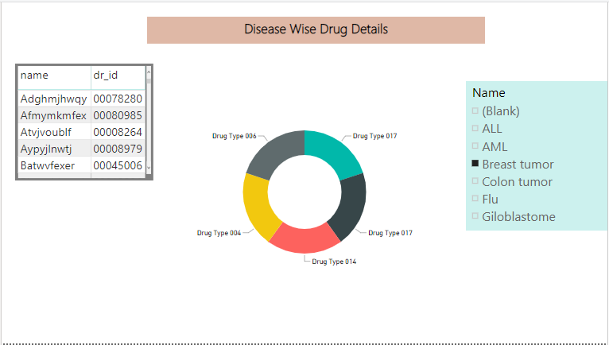

Slide 17
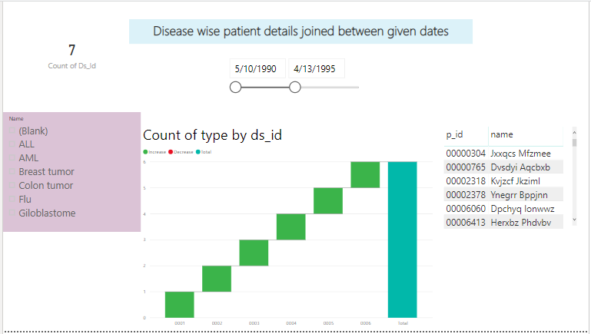

Slide 18
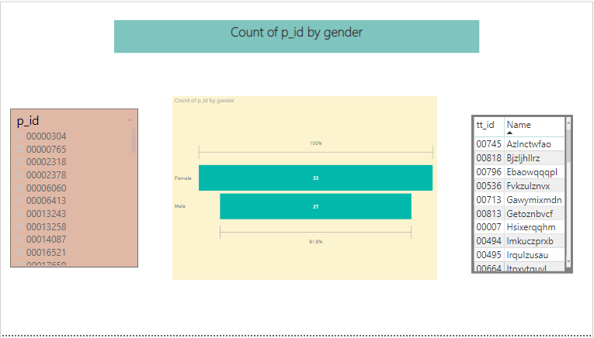

Slide 19
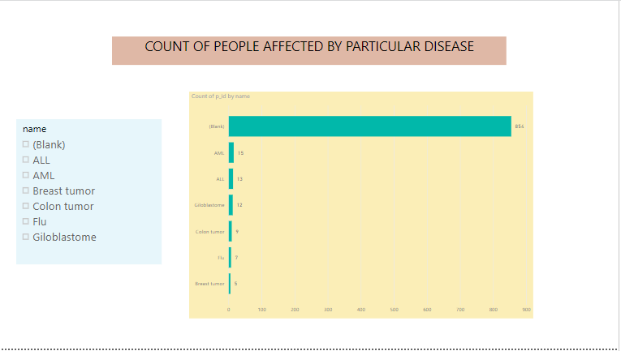

Slide 20
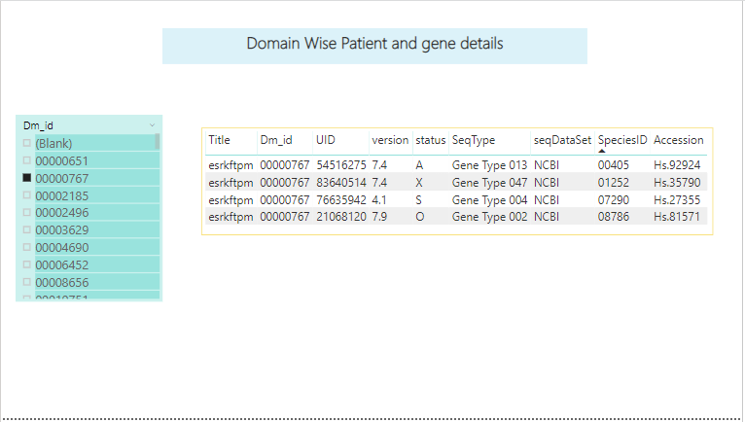

Slide 21
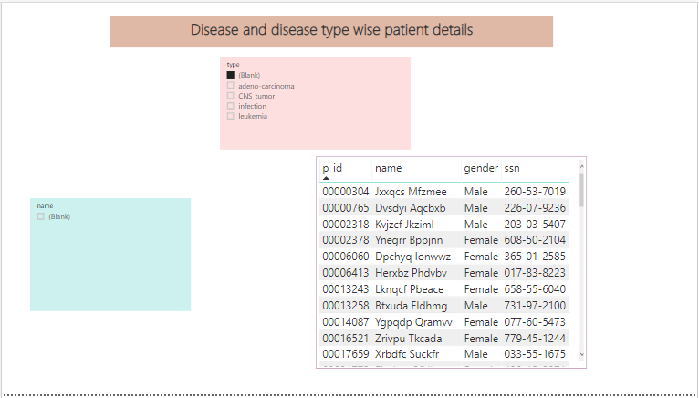

Slide 22
Thank you …

